Slide 1

Inter-city Car Pooling System System
Submitted By:
Mahesh Bhabhad (230343020055)
Tarun Rathore (230343020099)
Nikhil Madhekar (230343020052)
Mohsin Naqvi (230343020079)
Guided By:
Mrs: Bakul Joshi

Slide 2
Contents
Introduction​
Architecture
​Database Design
Technology platform used for project
User roles and responsibilities
Division of work within team
Details of contribution of each team members
File and directory structure for project
Read me file
Future extension if any
Conclusion

Slide 3
Introduction
The online carpooling system is a platform designed
to connect individuals who are traveling in the
same direction so they canshare a ride together.
It aims to provide a more sustainable and cost-effective
transportation option by reducing the number of vehicles
on the road and optimizing the use of existing resources.
Notes:
Hive and Hive QL statements have been used for querying the data.
For future scope, various different Machine Learning algo0rithm will be implemented on different flight delay datasets.

Slide 4
Project Architecture
Used for
User interfacing
Basic data validation
Used for
Server side validation
Response handling
Business Logic
Database operations
Used for
Permanent data storage
Database level validation
Database access using stored procedures
Front end Layer
Server Layer
Technologies used
HTML, CSS
Javascript, jQuery
ReactJS
JSON
Technologies used
Springboot
Hibernate
Database Layer

Slide 5
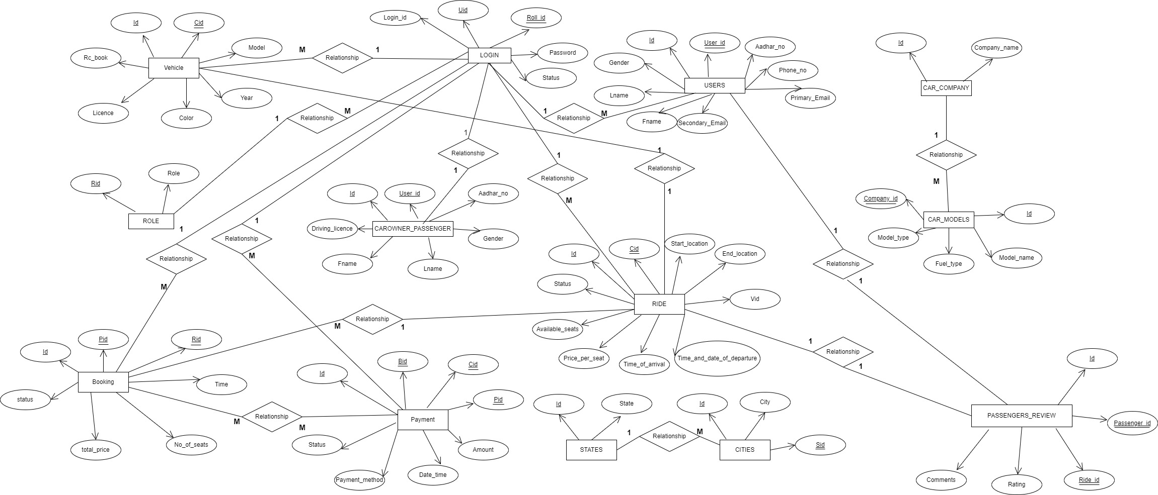
ER Diagram

Slide 6
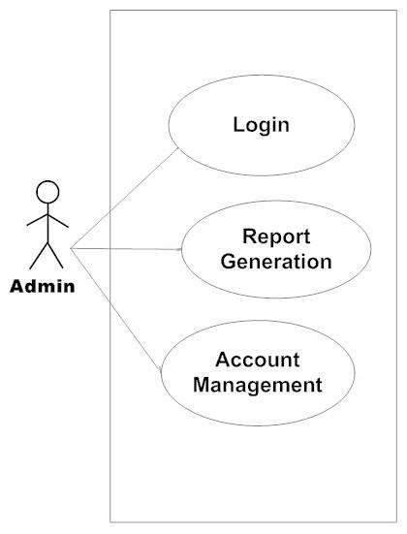
Use Case Diagram
1. Admin

Slide 7
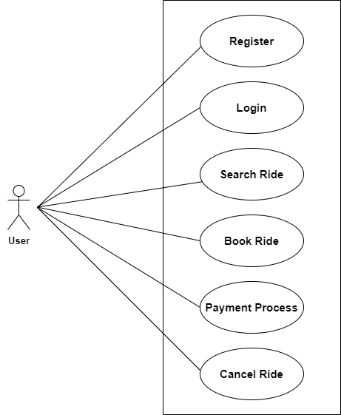
2. User

Slide 8
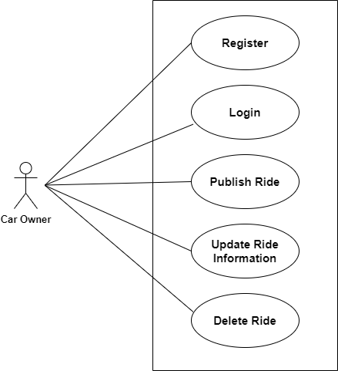
3. Car Owner

Slide 9
Technology platform used
Technologies used :
HTML, CSS, Javascript, jQuery, ReactJS, JSON, Springboot, Hibernate, MySQL
Reason :
Html, CSS and javascript are used for frontend part for static web pages.
React JS is used for rendering the dynamic web pages and to create a single page application where only particular part of web page is rendered without altering complete web page.
Springboot is used for server side processing wherein in connection with database is established from server and required data is manipulated and sent to client side.

Slide 10
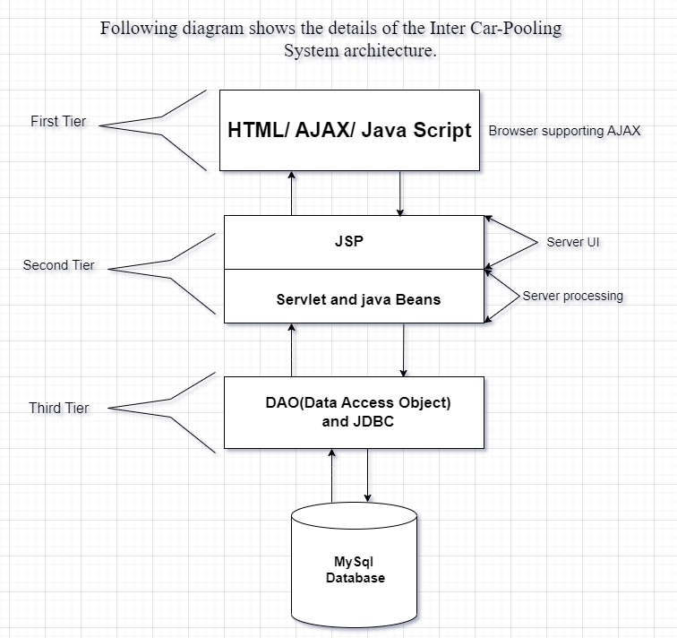
Technology platform used for Project

Slide 11
Roles and responsibitities
Roles
User
Passenger
Admin
Responsibilities of each user
User-
Passenger-get benifited from application.
Admin-Account management, permission to allow users and car-owner passenger.
User cases of each user
User-update profile,create ride ,delete ride,update ride.
Passenger-update profile,create ride ,delete ride,update ride.
Admin-allow car-owner,allow users.

Slide 12
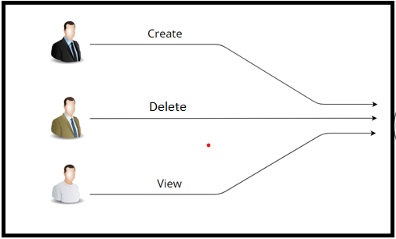
Working

Slide 13
Features
Admin can Allow Car-owners.
Admin can can delete Car-owner account.
Admin can manage account details.
User can create ride.
Car owner can add details and register ourself.
Car owner and user can create ride,delete ride.
Car owner can update his details.
User can add review to ride .
New user can be registered .

Slide 14
Benefits
Private Vehicle Owners: Individuals who own a car and offer rides to other users through the carpooling system.
It is very easy to use.
The individuals who have cars seats available for share transportation with others.
It saves a lot of time and money .
Eco-friendly: Government and Regulatory Authorities: Reduce traffic congestion and promote sustainable transportation.
Travelers: People who use carpooling for long-distance trips.

Slide 15
Benefits
Passenger seek shared rides with drivers heading towards in the same city. It provides custom features development and support with the application.

Slide 16
Conclusion
Challenges wChallenges you faced :
There were many challenges that we faced like finding a write path to start with, exploring the technologies beyond the horizon of our course Etc.
Things Learnt :
We have learnt to efficiently distribute the task within the team. We have learnt to combine all the dynamic stack of technologies together to create a fully functional software.
Overall Experience :
Overall experience was very practical oriented and highly knowledgeablee faced :

Slide 17
Future Scope
Carpooling is the sharing of car journeys so that more than one person travels in a car, and prevents the need for others to have to drive to a location themselves with own car.
Reduce traffic congestion – The benefits of carpooling on a large scale are huge. The software is flexible enough to be modified and implemented as per future requirements. We have tried our best to present this free and user–friendly website to Society.

Slide 18
THANK YOU

